Slide 1
Azure Ad for Developers

Slide 2
What is azure ad?
Is not replacement of your on premises windows active directory
Azure ad is more focused on internet scale and internet based protocol based active directory
Limitations of on premises active directory
- Single point of failure
On premises AD is not designed for internet scale
Too chatty – every resource access require to talk to domain controller – if you login outlook it requires to talk to domain controller, if you login to skype it requires to talk to domain controller.

Slide 3
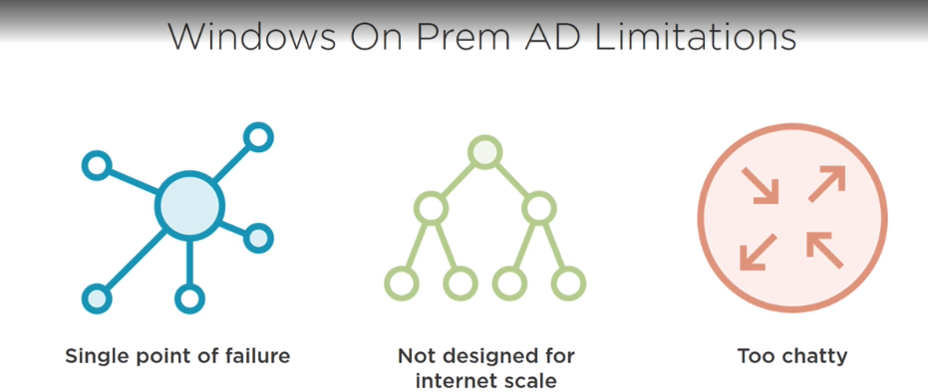

Slide 4
Azure AD
Identifies apps, apis, and users using internet ready starndards.
In internet we don’t use kerberose we use the oauth and ws fed.
Trust based architecture, less chatty

Slide 5
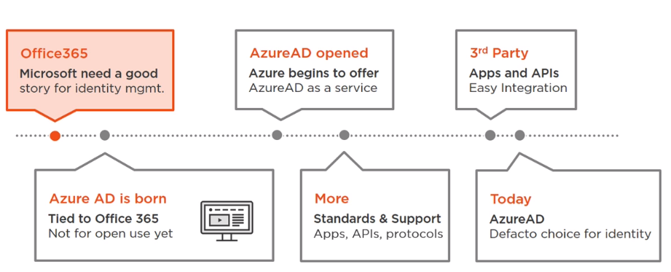

Slide 6
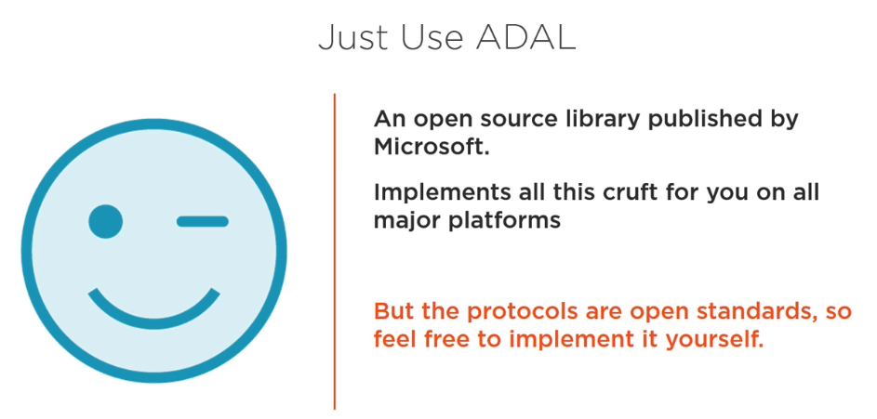

Slide 7
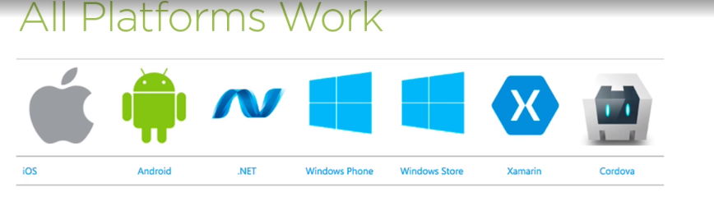

Slide 8
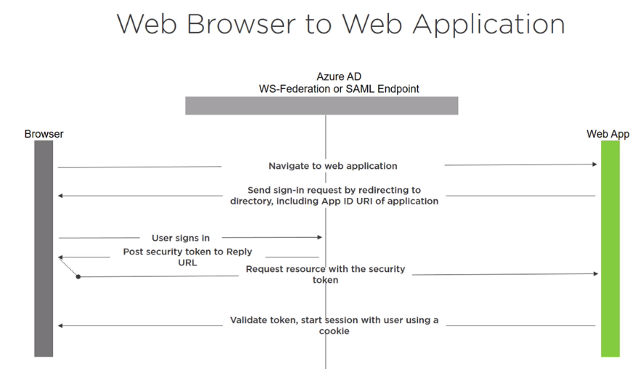
Web browser to web application – only using azure AD, App not hosted in azure

Slide 9
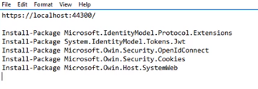

Demo – Settings – 4.5.1 required for owin
Install nugget packages

Slide 10
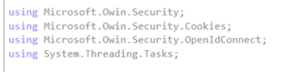
Add namespaces

Slide 11
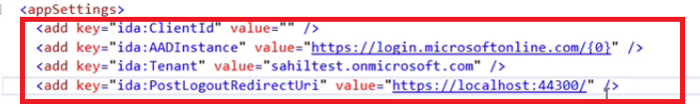
Add configuration

Slide 12
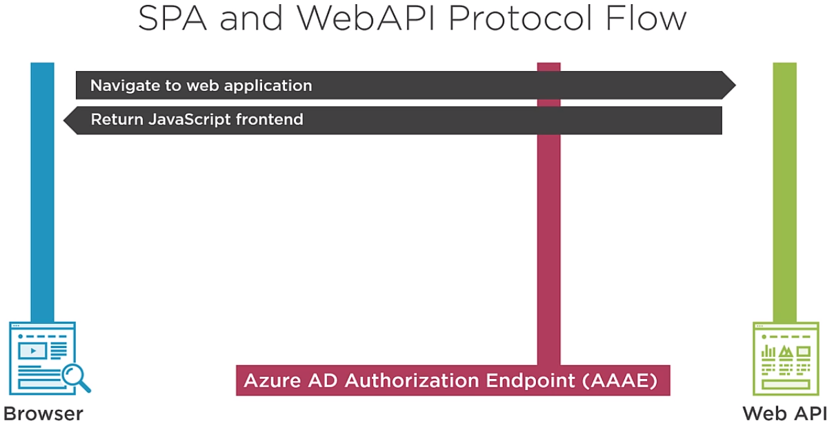

Slide 13
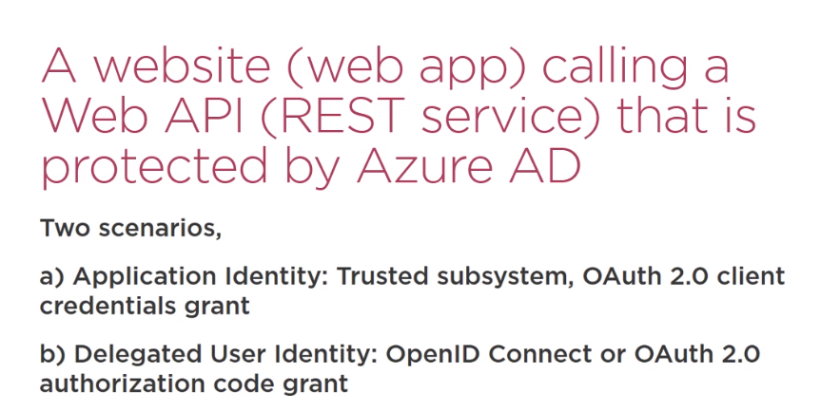

Slide 14
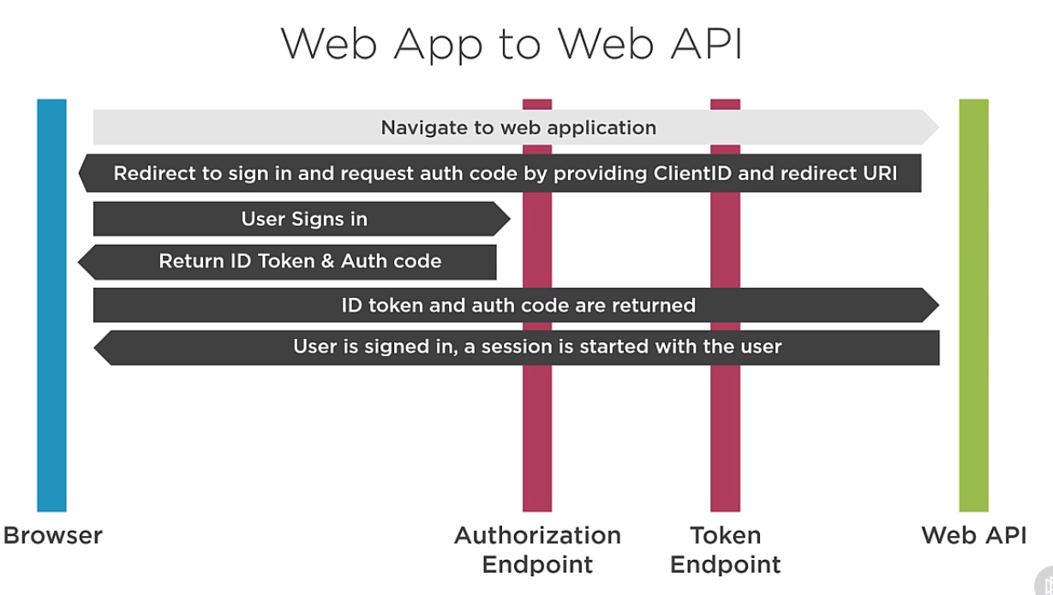

Slide 15
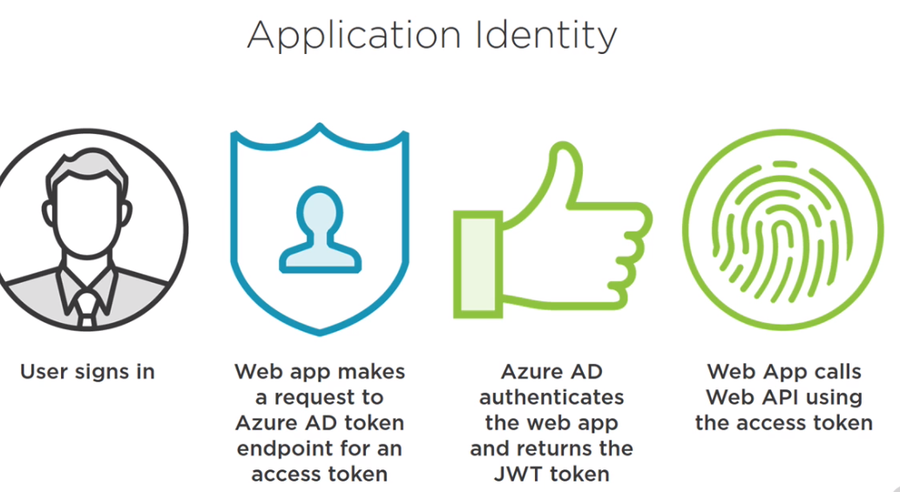

Slide 16
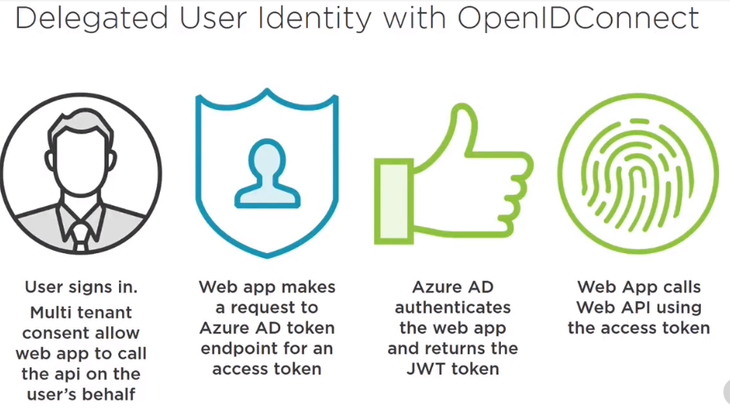
Delegated

Slide 17
